Slide 1

AirSential
Advanced Smart Device for Air Quality Monitoring, Gas Leak Detection, and Emergency Response
–- Safeguarding Respiratory Health with Intelligent Hazard Prevention
Sagarika Srivastava
e-mail : sagarikasrivastava46@gmail.com
LinkedIn : issrivastava46
GitHub : issrivastava

Slide 2

WHY ?
Air pollution harms health, causing respiratory and heart diseases, and leads to millions of premature deaths. It damages ecosystems, accelerates climate change, and threatens biodiversity. Economically, it strains healthcare, reduces productivity, and harms crops. If left unchecked, it causes irreversible environmental and societal damage.

Slide 3

Several IOT projects are present for air quality detection and gas leakage
however it is very expensive and one device performs only one specific function and is not very efficient.
Therfore,,i aim to create one device that can perform all functions and is affordable by a common man

Slide 4
Feature | AIR SENTIAL | Competitor A | Competitor B
Real-Time Monitoring | ✅ | ✅ | ❌
Gas Leak Detection | ✅ | ❌ | ❌
Emergency Alerts | ✅ | ✅ | ✅

Slide 5
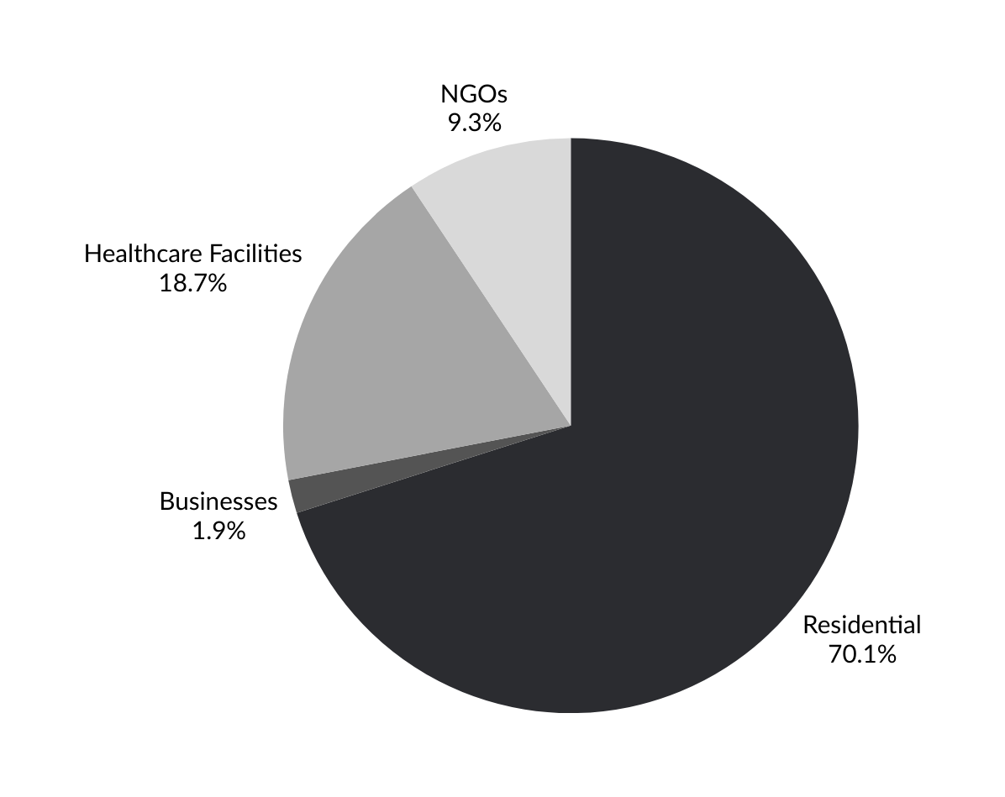
WHO ?

Slide 6
WHAT ?
This advanced device is designed to assist individuals with respiratory illnesses while enhancing safety in homes and offices. It features real-time air quality monitoring and gas leak detection, with intelligent systems to differentiate between harmless smoke (such as from incense or cigarettes) and dangerous smoke or gas leaks. Equipped with a small camera for human face detection and integrated smoke and gas alarms, the device covers large areas efficiently. It can automatically alert authorities in case of prolonged hazardous gas levels or fire emergencies, ensuring timely intervention.

Slide 7

COMPONENTS
1. Microcontroller
2. Wi-Fi Module
3. LCD Display
4. DC Fan
5. Diodes
6. IC && IC Sockets
7. Regulator
8. Transformer
9. Sensors
10. Capacitors
11. Transistors
12. Breadboard /cables /wires /PCB /switch /push buttons
13. Potentiometer
14. Buzzer
15. Resistors
16. crystal Oscillator
17. LEDs

Slide 8
FUNCTIONS OF MY DEVICE
•SENSOR TO DETECT AIR QUALITY AND CONTENTS PERCENTAGE WISE
O2-% CO2-% ETC
•LIGHT FOR INDICATION (RED YELLOW GREEN)
•DISPLAY AIR QUALITY
•ALARMING SYSTEM IN CASE OF FIRE
•LARGE RADIUS
•CAN TELL THE DIFF BETWEEN ACTUAL SMOKE AND A PERSON SMOKING
•WIFI CONNECTIVITY
•RUNS ON BATTERY FOR POWER SUPPLY
•ECONOMICAL
•ALL COMBINED IN ONE SINGLE DEVICE THAT CAN BE HANGED ON THE WALL

Slide 9
TRANSFORMER
RECTIFIER
VOLTAGE REGULATOR 5V-3.3V
SENSORS
WIFI
MICRO-CONTROLLER
DISPLAY
ALARMING SYSTEM

Slide 10








Thank You !

